Slide 1
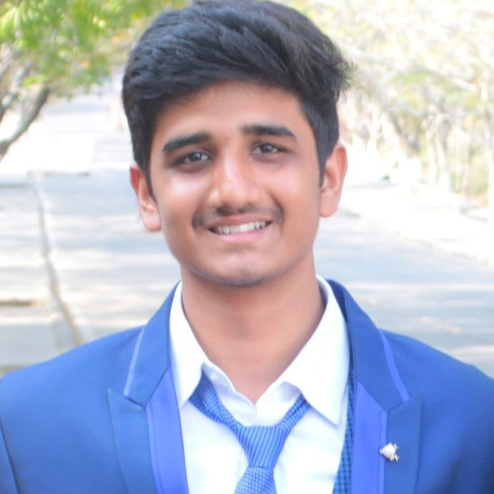
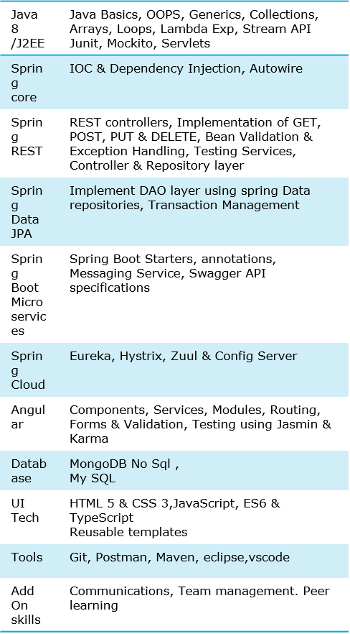



Mohammed Abdus Samee
Analyst/Software Engineer
Bachelor of Engineering
Computer Science : 2017 - 2021
Skills
Bangalore
abdus-samee.mohammed@capgemini.com
+91 9963868701
A4
Full Stack Developer
Hands on experience in creating microservices with Springboot, Spring Security, Spring Cloud API Gateway, Eureka server, resilience 4J, load balancing.
Proficient in creating Single page Web Application in Angular with Angular reactive forms, angular routing.
Hands on experience in developing web pages using HTML5, CSS3, Object Oriented Java script, ES6, JSON, XML. Good understanding of Document Object Model (DOM) and DOM Functions.
Experience in integrating Angular with spring boot and connecting spring boot to MongoDB
E-Commerce Shopping Cart Application
Completed end to end case study of Shopping Cart Application along , responsive UI with Bootstrap CSS and used Angular for user interface.
Web Development Course from Internshala
IBM AI Engineering from Coursera
Check out my work on GitHub & Video

